Slide 1
Kubernetes

Slide 2
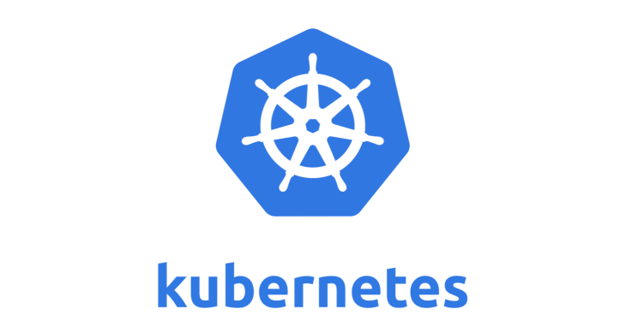
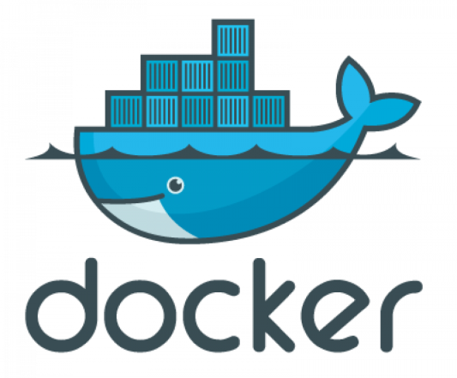
Kubernetes
Kubernetes also known as “k8s” or “kube” is a container orchestration platform for scheduling and automating the deployment, management, and scaling of containerized applications

Slide 3
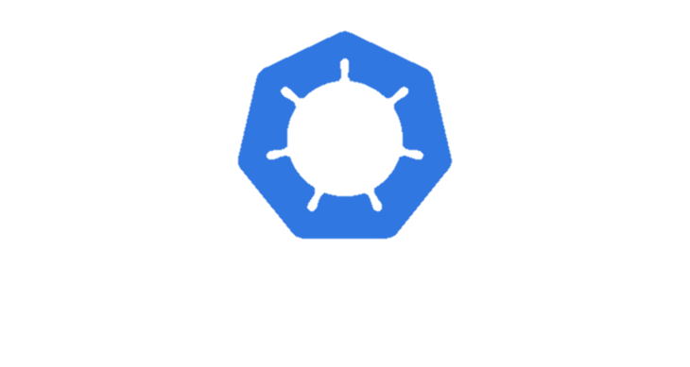
History
Kubernetes was first developed by engineers at Google before being open sourced in 2014.
It is a descendant of Borg,a container orchestration platform used internally at Google.
Google generates more than 2 billion container deployments a week, all powered by its internal platform, Borg.
Kubernetes is Greek for helmsman or pilot, hence the helm in the Kubernetes logo
Fun fact: The 7 spokes in the Kubernetes logo refer to the project’s original name, "Project Seven of Nine."

Slide 4
Kubernetes clusters?
In Kubernetes, a cluster refers to a group of computers (nodes) that work together to run containerized applications.
A Kubernetes cluster typically consists of a master node and multiple worker nodes. The master node acts as the control plane and manages the overall state of the cluster, while the worker nodes run the actual application containers.
Kubernetes clusters can span hosts across on-premise, public, private, or hybrid clouds. For this reason, Kubernetes is an ideal platform for hosting cloud-native applications that require rapid scaling

Slide 5
Kubernetes Components
An environment running Kubernetes consists of the following basic components:
a control plane (Kubernetes master)
a distributed key-value storage system for keeping the cluster state consistent (etcd)
cluster nodes (Kubelets, also called worker nodes or minions).

Slide 6
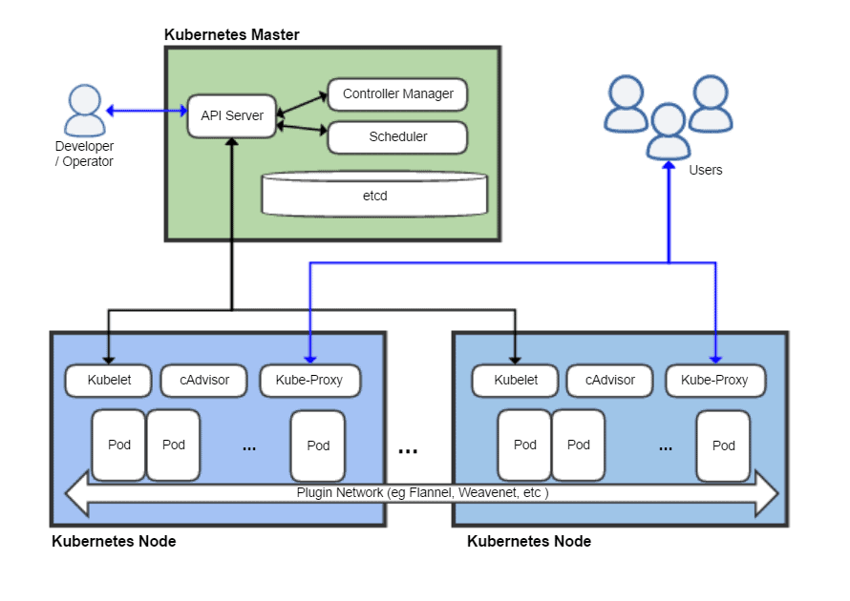
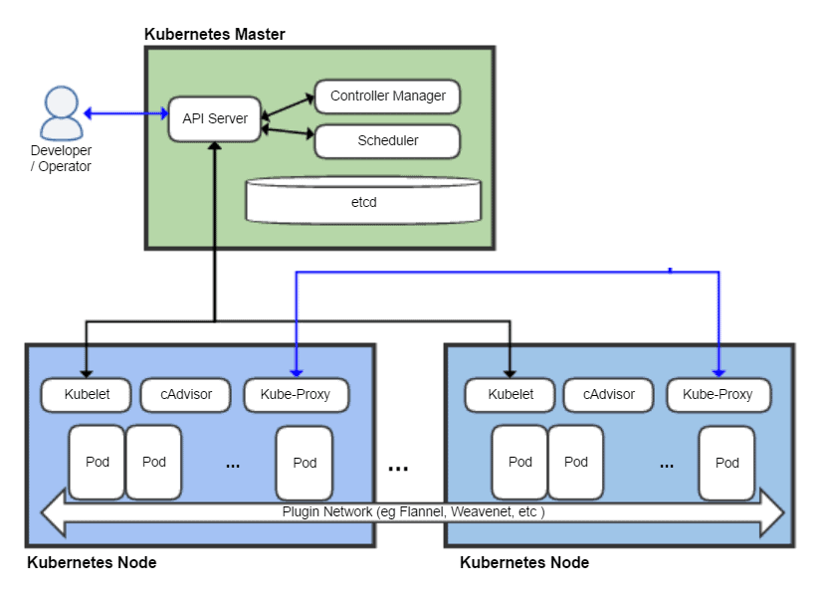

Slide 7
Kubernetes Architecture
Basic Kubernetes architecture exists in two parts: the control plane and the nodes or compute machines
Each node could be either a physical or virtual machine and is its own Linux environment. Every node also runs pods, which are composed of containers.
Kubernetes node components include a container runtime engine or docker, a Kubelet service, and a Kubernetes proxy service.

Slide 8
Kubernetes Control Plane
The control plane is the nerve center that houses Kubernetes cluster architecture components that control the cluster. It also maintains a data record of the configuration and state of all of the cluster’s Kubernetes objects
The Kubernetes control plane is in constant contact with the compute machines to ensure that the cluster runs as configured. Controllers respond to cluster changes to manage object states and drive the actual, observed state or current status of system objects to match the desired state or specification.

Slide 9
Several major components comprise the control plane: the API server, the scheduler, the controller-manager, and etcd
These core Kubernetes components ensure containers are running with the necessary resources in sufficient numbers
These components can all run on one master node, but many enterprises concerned about fault tolerance replicate them across multiple nodes to achieve high availability.

Slide 10
Kubernetes API Server
The Kubernetes API Server is a key component of the Kubernetes system.
It acts as the front-end for the Kubernetes control plane, providing a management interface for cluster operations and serving as the primary gateway for interacting with the cluster.
The API Server defines a set of resources, such as Pods, Services, Deployments, and Nodes, which can be created, updated, and deleted using the API.
The API Server handles authentication and authorization of incoming requests.
When a request is received, the API Server validates it, checks the user's permissions, and processes the request. It ensures the requested changes are consistent with the cluster's desired state and enforces any admission control policies configured.

Slide 11
Kubernetes Scheduler
The Kubernetes scheduler stores the resource usage data for each compute node; determines whether a cluster is healthy; and determines whether new containers should be deployed, and if so, where they should be placed.
The scheduler considers the health of the cluster generally alongside the pod’s resource demands, such as CPU or memory.
Then it selects an appropriate compute node and schedules the task, pod, or service, taking resource limitations or guarantees, data locality, the quality of the service requirements, and other factors into account.

Slide 12
Kubernetes Controller Manager
The controller manager is a daemon which runs the Kubernetes cluster using several controller functions.
The controller watches the objects it manages in the cluster as it runs the Kubernetes
It observes them for their desired state and current state via the API server. If the current and desired states of the managed objects don’t match, the controller takes corrective steps to drive object status toward the desired state.

Slide 13
ETCD
etcd is an open source, key-value store database that stores configuration data and information about the state of the cluster.
etcd may be configured externally, although it is often part of the Kubernetes control plane.

Slide 14
Cluster nodes
Managed by the control plane, cluster nodes are machines that run containers.
Each node runs an agent for communicating with the master, the kubelet
Each node also runs a container runtime engine, such as Docker or rkt
The node also runs additional components for monitoring, logging, service discovery, and optional extras.

Slide 15
Container Runtime Engine
Each compute node runs and manages container life cycles using a container runtime engine
Kubernetes supports Open Container Initiative-compliant runtimes such as Docker, rkt.

Slide 16
Kubelet service
Each compute node includes a kubelet, an agent that communicates with the master or control plane to ensure the containers in a pod are running
When the control plane requires a specific action happen in a node, the kubelet receives the pod specifications through the API server and executes the action
It then ensures the associated containers are healthy and running.

Slide 17
Kube-proxy service
Each compute node contains a network proxy called a kube-proxy that facilitates Kubernetes networking services
The kube-proxy either forwards traffic itself or relies on the packet filtering layer of the operating system to handle network communications both outside and inside the cluster.
The kube-proxy runs on each node to ensure that services are available to external parties
It serves as a network proxy and service load balancer on its node, managing the network routing for UDP and TCP packets
In fact, the kube-proxy routes traffic for all service endpoints.

Slide 18
Pods
A pod represents a single instance of an application, and the simplest unit within the Kubernetes
Each pod is composed of a container or group of containers in a series that logically go together, along with rules that control how the containers run.
Pods are also capable of horizontal autoscaling, meaning they can grow or shrink the number of instances running
Pods run together on nodes, so they share content and storage and can reach other pods

Slide 19
cAdvisor
cAdvisor is an open-source agent integrated into the kubelet binary that monitors resource usage and analyzes the performance of containers. It collects statistics about the CPU, memory, file, and network usage for all containers running on a given node

Slide 20
Companies using K8s
Since the launch of Kubernetes in July 2015, countless companies have shifted to the open-source container-orchestration system to improve the efficiency of deploying, scaling, and managing applications.
‍Google‍
Spotify‍
Capital One‍
The New York Times‍
Pinterest‍
Adidas‍
Airbnb

Slide 21
Article
https://devm.io/kubernetes/big-companies-using-kubernetes-159007

Slide 22
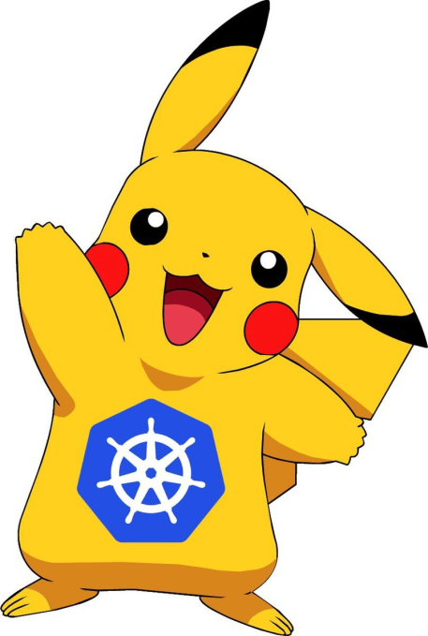
Pokemon Go and Kubernetes

Slide 23
Pokemon Go
Pokémon Go is an augmented reality app that combines real-world locations with gaming. It was developed and published by Niantic, Inc.

Slide 24
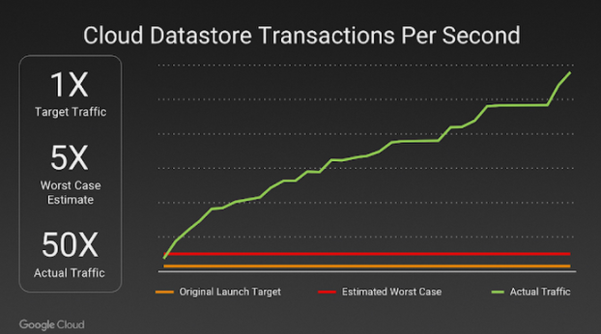
Pokemon Go was launched over Google Cloud. The teams targeted 1X player traffic, with a worst-case estimate of roughly 5X of this target
Within 15 minutes of launching in Australia and New Zealand, player traffic surged well past Niantic’s expectations.
Pokemon GO till today had more than 500+ million downloads and 20+ million daily active users

Slide 25
So how did they scale-out in so less Period of time?

Slide 26
The answer to this is containerization. Pokemon Go was a container-based application. The application logic for the game runs on Google Container Engine (GKE) powered by the open-source Kubernetes project.

Slide 27
Kubernetes
Kubernetes is an open-source container-orchestration system for automating computer application deployment, scaling, and management
It was originally designed by Google and is now maintained by the Cloud Native Computing Foundation
Kubernetes is currently the best tool for container orchestration.

Slide 28
Kubernetes service is provided by Google Cloud i.e., Google Kubernetes Engine
Google Kubernetes Engine (GKE) provides a managed environment for deploying, managing, and scaling your containerized applications using Google infrastructure
The GKE environment consists of multiple machines (Compute Engine instances) grouped together to form a cluster
Pokemon Go is the largest Kubernetes deployment ever on Google Container Engine.

Slide 29
A Kubernetes Deployment is used to tell Kubernetes how to create or modify instances of the pods that hold a containerized application
Deployments can scale the number of replica pods, enable the rollout of updated code in a controlled manner, or roll back to an earlier deployment version if necessary.
Deployments keep an eye on the pods and if any of the pods goes down due to any failure, it tries to get the pod back online
This means we do not have to keep on monitoring every container on every node on which the application is running.

Slide 30
Niantics and GoogleCloud were able to scale-out the nodes, thus the number of pods and thus, the number of containers running with the help of Kubernetes
Resources like deployments help to automate and manage the cluster of applications quite easily which very little downtime
This is how Niantics and Google Cloud were able to manage such huge traffic towards the game.

